Slide 1

UNIVERSITY INSTITUTE OF COMPUTING
MASTER OF COMPUTER APPLICATIONS
DESIGN AND ANALYSIS OF ALGORITHMS
UNIT-3
DISCOVER . LEARN . EMPOWER

Slide 2

Backtracking
Backtracking is a technique used to solve problems with a large search space, by systematically trying and eliminating possibilities.
A standard example of backtracking would be going through a maze.
At some point in a maze, you might have two options of which direction to go:
Junction
Portion A
Fig. 3.8: Backtracking
Portion B

Slide 3
Backtracking
One strategy would be to try going through Portion A of the maze.
If you get stuck before you find your way out, then you "backtrack" to the junction
At this point in time, you know that Portion A will NOT lead you out of the maze, so you then start searching in Portion B.
Clearly, at a single junction you could have even more than 2 choices.
The backtracking strategy says to try each choice, one after the other, if you ever get stuck, "backtrack" to the junction and try the next choice.
If you try all choices and never found a way out, then there is no solution to the maze.

Slide 4
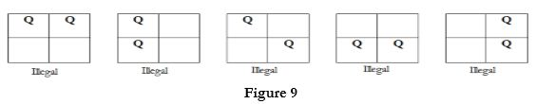
N Queen Problem
N-Queen problem is based on chess games.
The N-Queen problem states as consider a n x n chessboard on which we have to place n queens so that no two queens attack each other by being in the same row or in the same column or on the same diagonal.
For n =1, the problem has a trivial solution, and no solution exists for n =2 and n =3. So first we will consider the 4 queens' problem and then generate it to n - queens problem.

Slide 5
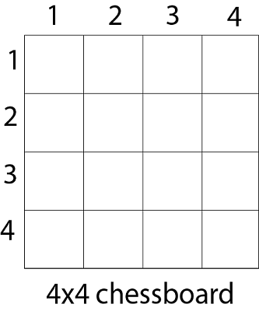
4 Queen Problem
Given a 4 x 4 chessboard and number the rows and column of the chessboard 1 through 4
Since, we have to place 4 queens such as q₁ q₂ q₃ and q₄ on the chessboard, such that no two queens attack each other. In such a conditional each queen must be placed on a different row, i.e., we put queen "i" on row "i.“
Place queen 1 in the first possible position of its row i.e. on 1st row and 1st column.

Slide 6
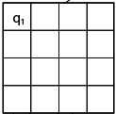
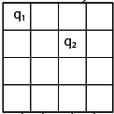
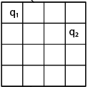
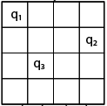
4 Queen Problem
Place queen 1 in the first possible position of its row i.e. on 1st row and 1st column.
Then place queen 2 after trying unsuccessful place (1, 2), (2, 1), (2, 2) at (2, 3) i.e. 2nd row and 3rd column.
This is a dead end because a 3rd queen cannot be placed in next column, as there is no acceptable position for queen 3. Hence algorithm backtracks and places the 2nd queen at (2, 4) position.

Slide 7
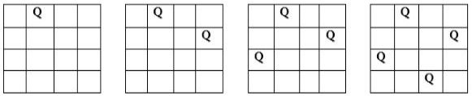
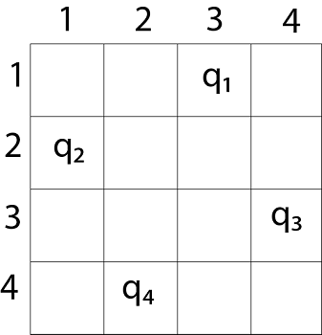
4 Queen Problem
Hence, we need to backtrack all the way up to queen 1 and move it to (1, 2).
Place queen 1 at (1, 2), queen 2 at (2, 4), queen 3 at (3, 1) and queen 4 at (4, 3).
we get the solution (2, 4, 1, 3). This is one possible solution for the 4-queens problem. For another possible solution, the whole method is repeated for all partial solutions. The other solutions for 4 - queens' problems is (3, 1, 4, 2)

Slide 8

Eight Queen Problem
Find an arrangement of 8 queens on a single chess board such that no two queens are attacking one another.
In chess, queens can move all the way down any row, column or diagonal (so long as no pieces are in the way).
Due to the first two restrictions, it's clear that each row and column of the board will have exactly one queen.

Slide 9
N Queen Problem
The backtracking strategy is as follows:
  Start in leftmost column.
  If all are placed, return true.
  Try all rows in current column
  Do following for every tried row
    If queen can be placed safely in this row then mark [r,c] as part of solution and recursively check if placing Q here leads to a solution.
    If placing leads to a solution, then return true.
    else unmark [r,c] and goto(a) to try other rows.
    If all rows have been tried and nothing worked, return False to trigger backtracking.

Slide 10
N Queen Problem
The backtracking strategy is as follows:
  Place a queen on the first available square in row 1.
  Move onto the next row, placing a queen on the first available square there (that doesn't conflict with the previously placed queens).
  Continue in this fashion until either:
    you have solved the problem, or
    you get stuck.
      When you get stuck, remove the queens that got you there, until you get to a row where there is another valid square to try.

Slide 11
Base case of recursive solution of N queen Problem
In the recursive solution of the N-Queens problem, the base case is the condition that terminates the recursion—i.e., when we have successfully placed queens on all N rows of the board.
if row == N:
# A valid solution is found
save_solution()
return
This means to place one queen per row. The recursion places queens' row by row. When you reach row == N, it means queens are placed safely on all N rows → you've found a valid solution.

Slide 12
Sum of Subset
In this problem, there is a given set with some integer elements. And another some value is also provided, we have to find a subset of the given set whose sum is the same as the given sum value.
Here backtracking approach is used for trying to select a valid subset when an item is not valid, we will backtrack to get the previous subset and add another element to get the solution.
Input:
This algorithm takes a set of numbers, and a sum value.
The Set: {10, 7, 5, 18, 12, 20, 15}
The sum Value: 35
Output:
All possible subsets of the given set, where sum of each element for every subsets is same as the given sum value.
{10, 7, 18}
{10, 5, 20}
{5, 18, 12}
{20, 15}

Slide 13
Steps in Backtracking (Sum of Subsets)
Initialization:
Start with an empty subset, an initial sum of 0, and a pointer (or index) to the first element of the set.
Recursive Exploration:
At each step (or recursive call), consider two choices for the current element:
  Include the element in the subset.
  Exclude the element from the subset.
Update State:
When including an element, add its value to the current sum and move to the next index.
When excluding, simply skip to the next index without changing the current sum.
Feasibility Check (Pruning):
If the current sum exceeds the target sum, terminate that recursive branch (backtrack).
This is called pruning, and it helps to avoid unnecessary computation.
Success Condition:
If the current sum is equal to the target sum, the current subset is a valid solution. It is either printed, stored, or counted.
Termination Condition:
If the index reaches the end of the set (i.e., all elements are considered), the recursion terminates — regardless of whether a solution is found.
Backtracking:
After exploring both the inclusion and exclusion of an element, the function backtracks to the previous state and explores other possibilities.

Slide 14
Steps in Backtracking (Sum of Subsets)
🔄
Recursive Call Structure:
Each recursive call branches into two further calls:
One with the current element included.
One with the current element excluded.
This forms a binary recursion tree, and in the worst case, all 2ⁿ subsets are explored.

Slide 15
The sum of subset problem is
NP-complete
The subset sum problem is NP-complete because it's a decision problem where finding a solution (a subset that sums to a target) is verifiable in polynomial time, but finding the solution itself requires potentially checking all possible subsets, which is computationally expensive and not solvable in polynomial time. Real-world applications include cryptography, knapsack problems, and resource allocation.
Why NP-Complete?
NP (Nondeterministic Polynomial Time):
The problem belongs to the class NP because if you're given a subset, you can quickly verify if it sums to the target value by simply adding the numbers in the subset. This verification is done in polynomial time (O(n) in this case).
NP-Completeness:
A problem is NP-complete if it's in NP and every other problem in NP can be reduced to it in polynomial time. This means if you could solve any NP-complete problem in polynomial time, you could solve all problems in NP in polynomial time.
Subset Sum Problem:
The subset sum problem asks: given a set of integers and a target sum, does any subset of those integers sum up to the target?
No Known Efficient Algorithm:
While verifying a solution is easy, finding the solution itself requires potentially checking every possible subset, which is an exponential operation (O(2^n)). There is no known polynomial-time algorithm to solve the general subset sum problem efficiently.

Slide 16
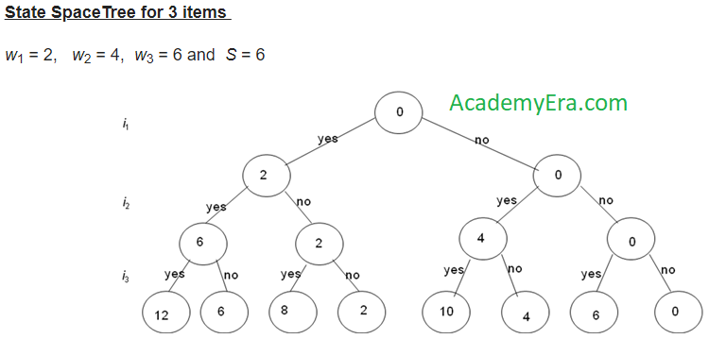
Sum of Subset

Slide 17
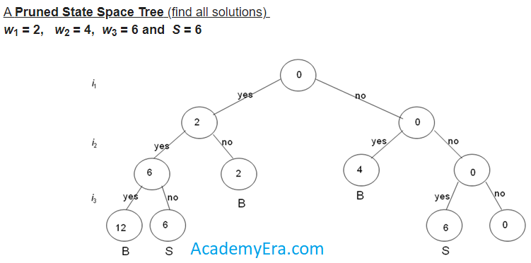


Sum of Subset

Slide 18
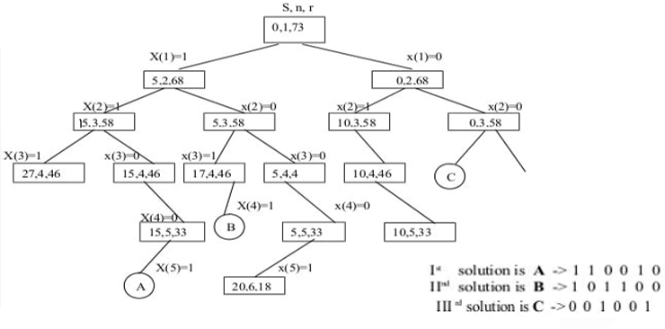
Sum of Subset
Solve following problem and draw portion of state space tree M=30,W ={5, 10, 12, 13, 15, 18}
Solve following problem and draw portion of state space tree M=30,W ={5, 10, 12, 13, 15, 18}

Slide 19
Sum of Subset
subsetSum(set, subset, n, subSize, total, node, sum)
Begin
if total = sum, then
display the subset
//go for finding next subset
subsetSum(set, subset, , subSize-1, total-set[node], node+1, sum)
return
else
for all element i in the set, do
subset[subSize] := set[i]
subSetSum(set, subset, n, subSize+1, total+set[i], i+1, sum)
done
End

Slide 20
Sum of Subsets Applications
Financial data analysis: The subset sum problem can be used to analyze and check the consistency of financial documents.
Automated auditing: The subset sum problem can be used in automated auditing.
Computer passwords: The subset sum problem can be used to verify a user's identity for computer access.

Slide 21
Time Complexity
Best Case
(Early Pruning Possible)When the solution is found early or many branches are pruned due to sum exceeding the target.
O(n).
Average Case
Some pruning happens, but not significantly.
O(2^n)
Worst Case (No Pruning)
All subsets are explored (e.g., all elements are small and can be part of the sum).
O(2^n)

Slide 22
Graph Coloring
Let G be undirected graph and let c be an integer.
Assignment of colors to the vertices or edges such that no two adjacent vertices are to be similarly colored.
We want to minimize the number of colors used.
The graph coloring optimization problem: find the minimum number of colors needed to color a graph.
The graph coloring decision problem: determine if there exists a coloring for a given graph which uses at most m colors.
Practical applications: scheduling, time-tabling, register allocation for compilers, coloring of maps.
A simple graph coloring algorithm - choose a color and an arbitrary starting vertex and color all the vertices that can be colored with that color.
Choose next starting vertex and next color and repeat the coloring until all the vertices are colored.

Slide 23
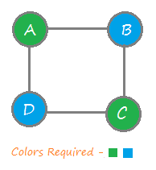
Graph Coloring
Graph coloring (also called vertex coloring) is a way of coloring a graph’s vertices such that no two adjacent vertices share the same color.
Graph coloring is a problem of coloring each vertex in graph in such a way that no two adjacent vertices have same color and yet m-colors are used. This problem is also called m-coloring problem. If the degree of given graph is d then we can color it with d + 1 colors.
The least possible value of ‘m’ required to color the graph successfully is known as the chromatic number of the given graph.

Slide 24
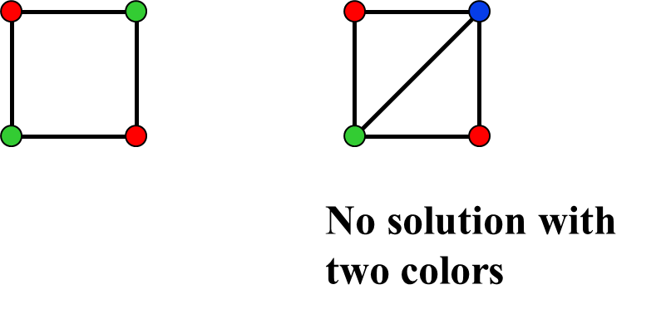
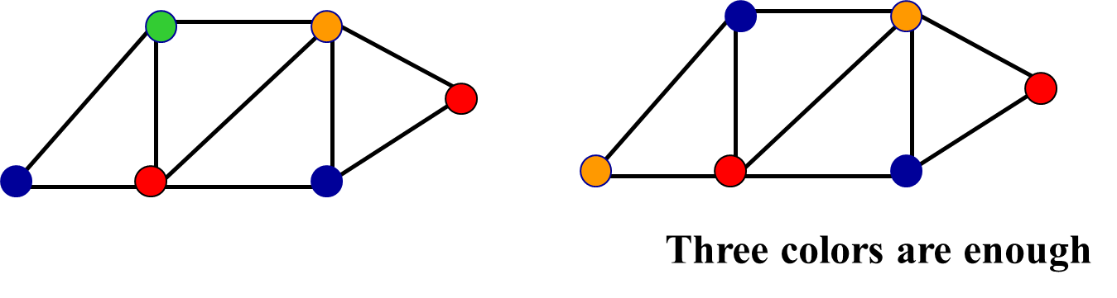
Graph Coloring Contd…
Fig. 3.13: Graph Coloring

Slide 25
Graph Coloring
Using backtracking algorithm approach, we color a single vertex and then move to its adjacent (connected) vertex to color it with different color.
After coloring, we again move to another adjacent vertex that is uncolored and repeat the process until all vertices of the given graph are colored.
In case, we find a vertex that has all adjacent vertices colored and no color is left to make it color different, we backtrack and change the color of the last colored vertices and again proceed further.
If by backtracking, we come back to the same vertex from where we started and all colors were tried on it, then it means the given number of colors (i.e. ‘m’) is insufficient to color the given graph and we require more colors (i.e. a bigger chromatic number).

Slide 26
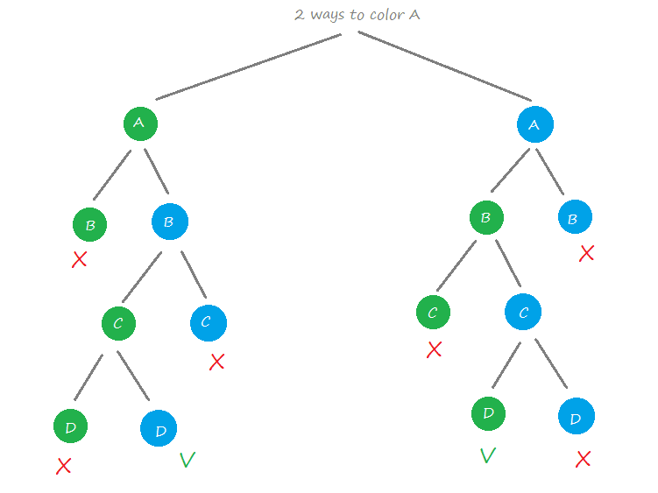
Graph Coloring Contd…
Fig. 3.13: Graph Coloring

Slide 27
Chromatic Number
The chromatic number of a graph is the minimum number of colors needed to color its vertices such that no two adjacent vertices have the same color.

Slide 28
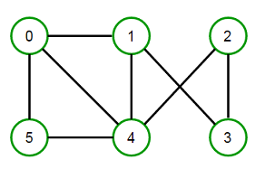
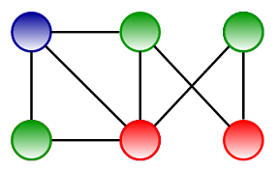
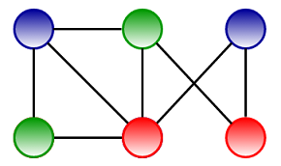
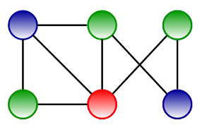
Graph Coloring
For example, consider the following graph:
We can color it in many ways by using the minimum of 3 colors.

Slide 29
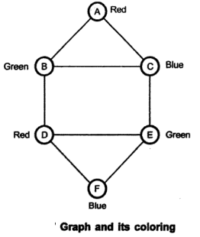
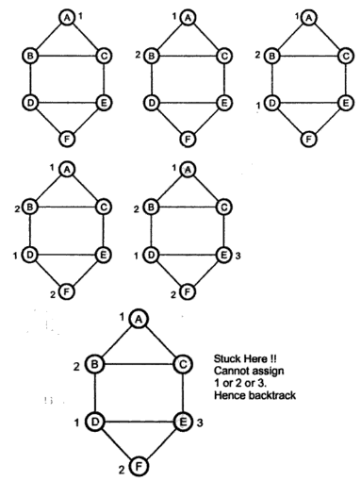
Graph Coloring Contd…
For example : Consider a graph given in Fig. We require three colors to color the graph. Hence the chromatic number of given graph is 3. We can use backtracking technique to solve the graph coloring problem as follows –

Slide 30
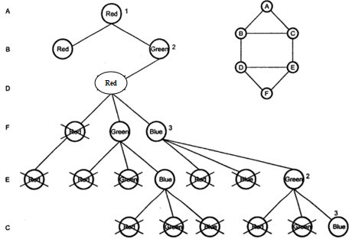
Graph Coloring Contd…
For example : Consider a graph given in Fig. We require three colors to color the graph. Hence the chromatic number of given graph is 3. We can use backtracking technique to solve the graph coloring problem as follows –

Slide 31
Graph Coloring
Steps To color graph using the Backtracking Algorithm:
Different colors:
  Confirm whether it is valid to color the current vertex with the current color (by checking whether any of its adjacent vertices are colored with the same color).
  If yes, then color it and otherwise try a different color.
  Check if all vertices are colored or not.
  If not, then move to the next adjacent uncolored vertex.
If no other color is available, then backtrack (i.e. un-color last colored vertex).
Here backtracking means to stop further recursive calls on adjacent vertices by returning false. In this algorithm Step-1.2 (Continue) and Step-2 (backtracking) is causing the program to try different color option.

Slide 32
Graph Coloring Applications
Scheduling: Graph coloring can help with scheduling problems like exam scheduling, timetabling, and aircraft scheduling. For example, in a classroom scheduling problem, each elective course can be represented by a vertex, and classes can be represented by edges.
Resource allocation: Graph coloring can be used to allocate resources.
Network analysis: Graph coloring can be used to model communications networks.
Image segmentation: Graph coloring can be used in image segmentation.
Data mining: Graph coloring can be used in data mining.
Clustering: Graph coloring can be used in clustering.
Image capturing: Graph coloring can be used in image capturing.
Frequency assignment: Graph coloring can be used in frequency assignment for radio stations.

Slide 33
Welsh-Powell algorithm
Determine the vertices' degrees and sort them in decreasing order.
Set the allotted colours for each vertex's location in an array.
Repeat step 2 over the vertices in the order determined there.
Give each vertex the smallest colour that isn't already being utilised by its neighbouring vertices.

Slide 34
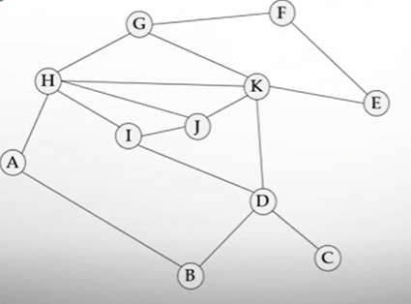
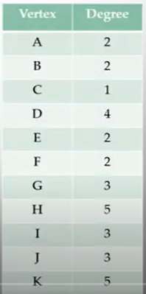
Welsh-Powell algorithm
Now arrange in descending order of their degree.
New Order is H,K,D,G,I,J,A,B,E,F,C

Slide 35
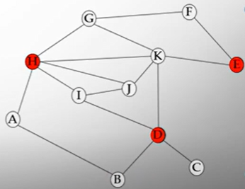
Welsh-Powell algorithm
For coloring the graph:
Order is: H,K,D,G,I,J,A,B,E,F,C
Try Red Color
H-Color Red
K-Don’t color Red, as it connects to H
D-Color Red
G-Don’t color Red, as it connects to H
I-Don’t color Red, as it connects to H
J-Don’t color Red, as it connects to H
A-Don’t color Red, as it connects to H
B-Don’t color Red, as it connects to D
E-Color Red
F-Don’t color Red, as it connects to E
C-Don’t color Red, as it connects to D

Slide 36
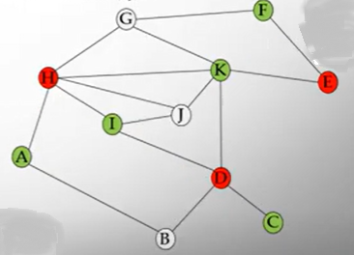
Welsh-Powell algorithm
Ignoring the vertices already coloured:
Rest vertices are: K,G,I,J,A,B,F,C
Now try Green Color
K-Color Green
G-Don’t color Green, as it connects to K
I-Color Green
J-Don’t color Green, as it connects to I
A-Color Green
B-Don’t color Green, as it connects to A
F-Color Green
C-Color Green

Slide 37
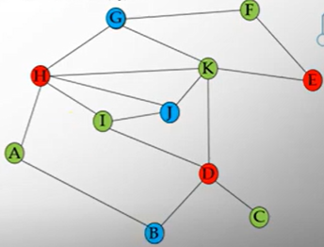
Welsh-Powell algorithm
Ignoring the vertices already coloured:
Rest vertices are: G,J,B
Now Try Blue Color
G-Color Blue
J-Color Blue
B-Color Blue

Slide 38
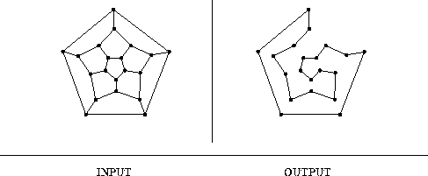
Hamiltonian Cycles
Hamiltonian cycle (HC): is a cycle which passes once and exactly once through every vertex of G (G can be digraph).
Hamiltonian path: is a path which passes once and exactly once through every vertex of G (G can be digraph).
A graph is Hamiltonian iff a Hamiltonian cycle (HC) exists.

Slide 39
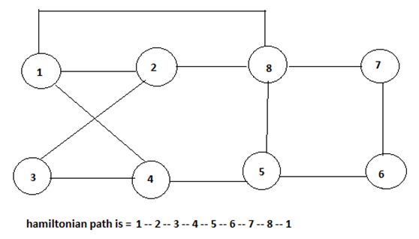
Hamiltonian Cycles
A Hamiltonian graph is the directed or undirected graph containing a Hamiltonian cycle. The Hamiltonian cycle is the cycle that traverses all the vertices of the given graph G exactly once and then ends at the starting vertex.
The input for the Hamiltonian graph problem can be the directed or undirected graph. The Hamiltonian problem involves checking if the Hamiltonian cycle is present in a graph G or not.

Slide 40
Hamiltonian Cycles
In an undirected graph, the Hamiltonian path is a path, that visits each vertex exactly once, and the Hamiltonian cycle or circuit is a Hamiltonian path, that there is an edge from the last vertex to the first vertex.
In this problem, we will try to determine whether a graph contains a Hamiltonian cycle or not. And when a Hamiltonian cycle is present, also print the cycle.

Slide 41
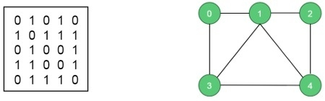
Hamiltonian Cycles
Input: The adjacency matrix of a graph G(V, E).
Output: The algorithm finds the Hamiltonian path of the given graph. For this case it is (0, 1, 2, 4, 3, 0). This graph has some other Hamiltonian paths. If one graph has no Hamiltonian path, the algorithm should return false.

Slide 42
Algorithm
Algorithm
isValid(v, k)
Input − Vertex v and position k.
Output − Checks whether placing v in the position k is valid or not.
Begin
if there is no edge between node(k-1) to v, then
return false
if v is already taken, then
return false
return true; //otherwise it is valid
End

Slide 43
Algorithm
cycleFound(node k)
Input − node of the graph.
Output − True when there is a Hamiltonian Cycle, otherwise false.
Begin
if all nodes are included, then
if there is an edge between nodes k and 0, then
return true
else
return false; for all vertex v except starting point, do
if isValid(v, k), then //when v is a valid edge
add v into the path
if cycleFound(k+1) is true, then
return true
otherwise remove v from the path
done
return false
End

Slide 44
Example
#include<iostream>
#define NODE 5 using namespace std;
int graph[NODE][NODE] = { {0, 1, 0, 1, 0},
{1, 0, 1, 1, 1},
{0, 1, 0, 0, 1},
{1, 1, 0, 0, 1},
{0, 1, 1, 1, 0}, };
/* int graph[NODE][NODE] = {
{0, 1, 0, 1, 0},
{1, 0, 1, 1, 1},
{0, 1, 0, 0, 1},
{1, 1, 0, 0, 0},
{0, 1, 1, 0, 0}, }; */

Slide 45
Example
int path[NODE];
void displayCycle()
{
cout<<"Cycle: ";
for (int i = 0; i < NODE; i++)
cout << path[i] << " ";
cout << path[0] << endl; //print the first vertex again
}
bool isValid(int v, int k)
{
if (graph [path[k-1]][v] == 0) //if there is no edge
return false;

Slide 46
Example
for (int v = 1; v < NODE; v++)
{ //for all vertices except starting point
if (isValid(v,k))
{ //if possible to add v in the path
path[k] = v;
if (cycleFound (k+1) == true)
return true;
path[k] = -1; //when k vertex will not in the solution
}
}
return false;
}

Slide 47
Example
bool hamiltonianCycle()
{ for (int i = 0; i < NODE; i++)
path[i] = -1;
path[0] = 0; //first vertex as 0
if ( cycleFound(1) == false )
{
cout << "Solution does not exist"<<endl;
return false;
}

Slide 48
Hamiltonian Cycles
Search all the potential solutions
Employ pruning of some kind to restrict the amount of researching
Advantages:
Find all solution, can decide HC exists or not
Disadvantages:
Worst case, needs exponential time. Normally, take a long time

Slide 49
Applications of Hamiltonian Cycles
Traveling Salesman Problem (TSP)
Routing and logistics
Network topology design
Circuit and VLSI design
Genome sequencing (DNA assembly)
Puzzle solving (e.g., Knight’s Tour)
Robotics path planning
Scheduling problems
Data clustering
Complexity theory and NP-completeness studies

Slide 50
Branch and Bound
Branch and bound is a strategy that uses state space tree to solve a problem.
It is used to solve optimization problems and minimization problems, but not maximization problems.
Although we can convert maximization problems into minization problems and then can solve by it.
It works with breadth first method.

Slide 51
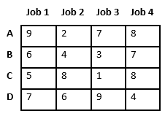
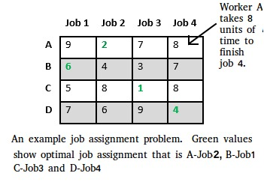
Assignment Problem using Branch and Bound
Let there be N workers and N jobs. Any worker can be assigned to perform any job, incurring some cost that may vary depending on the work-job assignment. It is required to perform all jobs by assigning exactly one worker to each job and exactly one job to each agent in such a way that the total cost of the assignment is minimized.

Slide 52
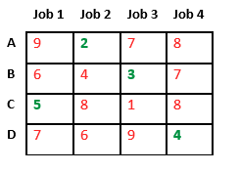
Assignment Problem using Branch and Bound
Let’s take below example and try to calculate promising cost that can be assigned to different workers.
Find minimum of every row keeping constraints of job assigning in mind.
Total minimum cost= 2+3+5+4=14

Slide 53
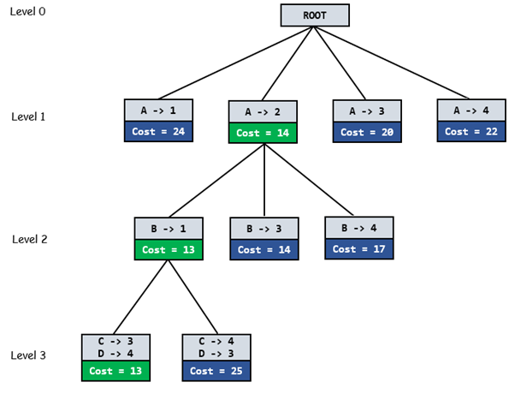
Assignment Problem using Branch and Bound
The diagram shows complete search space diagram showing optimal solution path in green.

Slide 54
0/1 Knapsack Problem using Branch and Bound
Given two arrays v[] and w[] that represent values and weights associated with n items respectively. Find out the maximum value subset(Maximum Profit) of v[] such that sum of the weights of this subset is smaller than or equal to Knapsack capacity Cap(W).
We have a bound that none of the items can have sum more than the capacity of knapsack and must give the maximum possible values.
We compute bound (best solution) for every node and compare the bound with current best solution before exploring the node.
The implicit tree for this problem is constructed as binary tree, where left branch signifies the inclusion of the items and right branch signifies the exclusion of the items.

Slide 55

0/1 Knapsack Problem using Branch and Bound
The node has three parts:
where
v=value of the item
w=weight of the item
W=total weight of knapsack
Consider the example given, where weight of the knapsack W=10
Item | Weight | Value | Value/weight
1 | 4 | 40 | 10
2 | 7 | 42 | 6
3 | 5 | 25 | 5
4 | 3 | 12 | 4

Slide 56
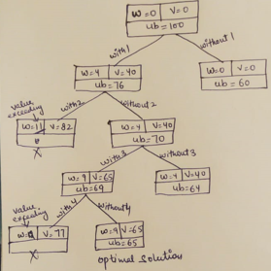
UB=0+(10-0)*(40/4)=100 (For Root node)
Items selected in the solution are {1,3}
Item | Weight | Value | Value/weight
1 | 4 | 40 | 10
2 | 7 | 42 | 6
3 | 5 | 25 | 5
4 | 3 | 12 | 4

Slide 57
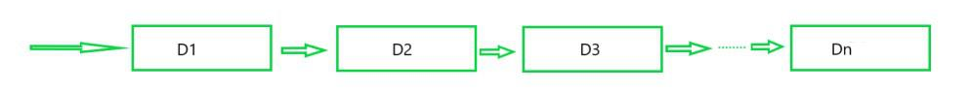
Reliability Design(Dynamic Programming)
The reliability design problem is the designing of a system composed of several devices connected in series or parallel. Reliability means the probability to get the success of the device.
Let’s say, we have to set up a system consisting of D1, D2, D3, …………, and Dn devices, each device has some costs C1, C2, C3, …….., Cn. Each device has a reliability of 0.9 then the entire system has reliability which is equal to the product of the reliabilities of all devices i.e., πri = (0.9)4.
It means that 35% of the system has a chance to fail, due to the failure of any one device.

Slide 58
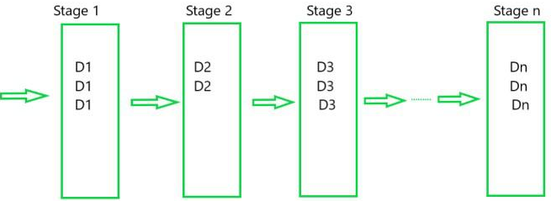
Reliability Design(Dynamic Programming)
The problem is that we want to construct a system whose reliability is maximum. How it can be done so?
We can think that we can take more than one copy of each device so that if one device fails we can use the copy of that device, which means we can connect the devices parallel.
When the same type of 3 devices is connected parallelly in stage 1 having a reliability 0.9 each then:
Reliability of device1, r1= 0.9
The probability that device does not work well = 1 – r1 = 1 – 0.9 = 0.1
The probability that all three copies failed = ( 1-r1 )³ = (0.1)³ = 0.001
The Probability that all three copies work properly = 1 – (1- r1)³ = 1- 0.001 = 0.999
We can see that the system with multiple copies of the same device parallel may increase the reliability of the system.

Slide 59
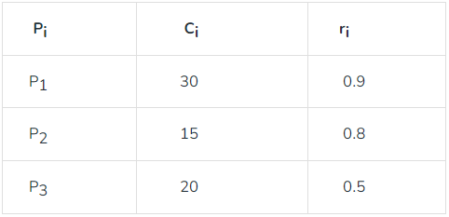
Reliability Design(Dynamic Programming)
Given a cost C and we have to set up a system by buying the devices and we need to find number of copies of each device under the cost such that reliability of a system is maximized.
We have to design a three-stage system with device types D1, D2, and D3. The costs are $30, $15, and $20 respectively. The cost of the system is to be no more than $105. The reliability of each device type is 0.9, 0.8, and 0.5 respectively.
Given that we have total cost C = 105,
Sum of all Ci = 30 + 15 + 20 = 65, the remaining amount we can use to buy a copy of each device in such a way that the reliability of the system, may increase.

Slide 60
Reliability Design(Dynamic Programming)
Remaining amount = C – sum of Ci = 105 – 65 = 40
Now, let us calculate how many copies of each device we can buy with $40, If consume all $40 in device1 then we can buy 40/30 = 1 and 1 copy we have already so overall 2 copies of device1. Now In general, we can have the formula to calculate the upper bond of each device:
Ui = floor( C – ∑Ci / Ci ) + 1 (1 is added because we have one copy of each device before)
C1=30, C2=15, C3=20, C=105
r1=0.9, r2=0.8, r3=0.5
u1 = floor ((105+30-(30+15+20))/30) = 2
u2 = 3
u3 = 3
Device | Cost | Reliability | UB (UpperBpund)
D1 | 30 | 0.9 | 2
D2 | 15 | 0.8 | 3
D3 | 20 | 0.5 | 3

Slide 61
Reliability Design(Dynamic Programming)
A tuple is just an ordered pair containing reliability and total cost up to a choice of mi’s that has been made. we can make pair in of Reliability and Cost of each stage like copySdevice S⁰ = {(1,0)}
Device 1:
Each S^{i} from S^{i-1} by trying out all possible values for r_{i} and combining the resulting tuples together.
let us consider P₁ :
¹S₁ = {(0.9, 30)} where 0.9 is the reliability of stage1 with a copy of one device and 30 is the cost of P1.
Now, two copies of device1 so, we can take one more copy as:
²S₁ = { (0.99, 60) } where 0.99 is the reliability of stage one with two copies of device, we can see that it will come as: 1 – ( 1 – r1 )2 = 1 – (1 – 0.9)2 = 1 – 0.01 = 0.99 .
After combining both conditions of Stage1 i.e., with copy one and copy of 2 devices respectively.
S¹ = { ( 0.9, 30 ), ( 0.99, 60 ) }

Slide 62
Reliability Design(Dynamic Programming)
Device 2:
S² will contain all reliability and cost pairs that we will get by taking all possible values for the stage2 in conjunction with possibilities calculated in S1.
First of all we will check the reliability at stage2 when we have 1, 2, and 3 as a copy of device. let us assume that Ei is the reliability of the particular stage with n number of devices, so for S2 we first calculate:
E2 (with copy 1) = 1 – ( 1 – r₂ )1 = 1 – ( 1 – 0.8 ) = 0.8
E2 (with copy 2) = 1 – (1 – r₂)2 = 1 – (1 – 0.8 )² = 0.96
E2 (with copy 3) = 1 – (1 – r₂ )3 = 1 – ( 1 – 0.8 )³ = 0.992
If we use 1 copy of P1 and 1 copy of P2 reliability will be 0.9*0.8 and the cost will be 30+15
One Copy of Device two , 1S2 = { (0.8, 15) } Conjunction with S1 (0.9, 30) = { (0.72,45) }
Similarly, we can calculate other pairs as S2 = ( 0.72, 45 ), ( 0.792, 75), ( 0.864, 60), ( 0.98,90 ) }
We get ordered pair (0.98,90) in S2 when we take 2 copies of Device1and 2 copies of Device2 However, with the remaining cost of 15 (105 – 90), we cannot use device Device3 (we need a minimum of 1 copy of every device in any stage), therefore ( 0.792, 75) should be discarded and other ordered pairs like it. We get S2 = { ( 0.72, 45 ), ( 0.864, 60 ), ( 0.98,90 ) }. There are other possible ordered pairs too, but all of them exceed cost limitations.
Up to this point we got ordered pairs:
S1 = { ( 0.9, 30), ( 0.99, 60 ) }
S2 = { ( 0.72, 45 ), ( 0.864, 60 ), ( 0.98,90 )}

Slide 63
Reliability Design(Dynamic Programming)
Device 3:
First of all we will check the reliability at stage3 when we have 1, 2, and 3 as a copy of device. Ei is the reliability of the particular stage with n number of devices, so for S3 we first calculate:
E3 (with copy 1) = 1 – ( 1 – r3 )1 = 1 – ( 1 – 0.5 ) = 0.5
E3 (with copy 2) = 1 – (1 – r3 )2 = 1 – (1 – 0.5 )2 = 0.75
E3 (with copy 3) = 1 – (1 – r3 )3 = 1 – ( 1 – 0.5 )3 = 0.875
Now, possible ordered pairs of device three are as- S³ = { ( 0.36, 65), ( 0.396, 95), ( 0.432, 80), ( 0.54, 85), ( 0.648, 100 ), ( 0.63, 105 ) }
(0.648,100) is the solution pair, 0.648 is the maximum reliability we can get under the cost constraint of 105.

Slide 64
References
Introduction to Algorithms by Coreman, Leiserson, Rivest, Stein.
Fundamentals of Algorithms by Ellis Horwitz, Sartaj Sahni, Sanguthevar Rajasekaran

Slide 65
THANK YOU
For any Queries-
E-Mail: gurpreetkaur.uic@cumail.in

